Slide 1
AI SOLUTIONS FOR FARMERS
PIP2001 Capstone Project
Review-1
Batch Number:
28
20211CSE0073 | P SUDHARSHAN REDDY
20211CSE0113 | B KOTESWAR REDDY
20211CSE0070 | Y SHIVA SHANKAR REDDY
20211CSE0096 | P SAILENDRA
Under the Supervision of,
Ms. Ayesha Taranum
Assistant Professor
School of Computer Science and Engineering
Presidency University
Roll Number | Student Name
Name of the Program: Computer Science and Engineering(CSE)
Name of the HoD: Dr. Asif Mohammed
Name of the Program Project Coordinator: Mr. Amarnath J L
Name of the School Project Coordinators: Dr. Sampath A K / Dr. Abdul Khadar A / Mr. Md Ziaur Rahman

Slide 2
Introduction
Agricultural productivity prediction is a critical component in optimizing food production, managing resources, and supporting sustainable agricultural practices. This study proposes a predictive model for estimating crop yield based on key agronomic parameters such as region name, crop types, pesticides used, humidity, and soil type. These variables are instrumental in determining the growth conditions of crops and, consequently, the yield. By using AI machine learning algorithms to analyze historical data, the model identifies patterns and relationships between these parameters and yield outcomes. The predictive model offers potential to assist farmers and policymakers in making informed decisions, mitigating risks associated with unpredictable factors like rainfall and climate change. Additionally, it promotes efficient resource management by anticipating crop demands, allowing for better planning and allocation of pesticides and fertilizers. This approach is anticipated to contribute significantly to decision making for farmers based on conditions and detect the problems by predicting solutions.

Slide 3
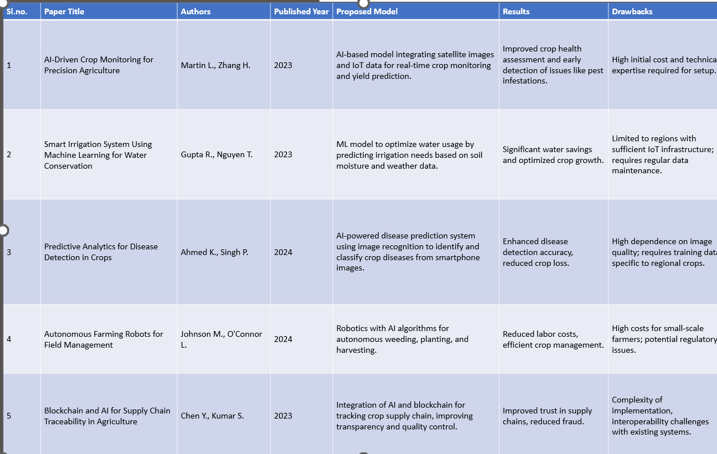
Literature Review

Slide 4
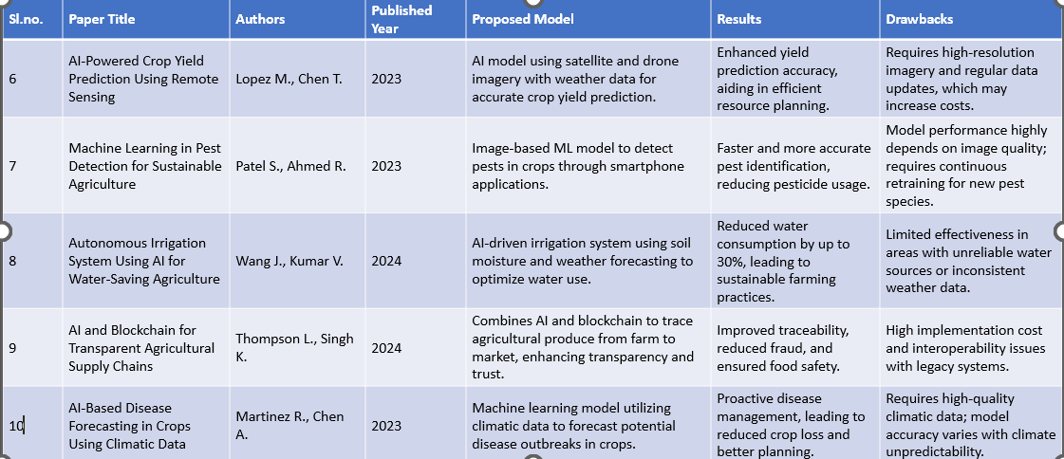
Literature Review

Slide 5
Existing method Drawback
AI-Powered Crop Yield Prediction Using Remote Sensing: Existing methods require high-resolution satellite or drone imagery, making them costly and dependent on regular data updates for accuracy.
Machine Learning in Pest Detection for Sustainable Agriculture: These methods rely heavily on high-quality images for pest identification, and models must be frequently retrained to recognize new pest species, which can be resource-intensive.
Autonomous Irrigation System Using AI for Water-Saving Agriculture: The effectiveness of current systems is limited in regions with unreliable water sources or inconsistent weather patterns, reducing their applicability in diverse climates.
AI and Blockchain for Transparent Agricultural Supply Chains: Implementing such solutions involves high costs and faces challenges with interoperability when integrated with older, existing systems in the supply chain.

Slide 6
Proposed Method
Data Collection and Preprocessing: Gather data from sources like soil, climate databases, crop records, and satellite imagery. Clean the data to remove noise, handle missing values, and standardize formats. Label or categorize data where necessary to suit the target objectives, such as predicting yield or detecting diseases.
Feature Selection: Identify and select the most relevant variables (features) that directly impact farm productivity, such as soil moisture, temperature, and crop type. Reducing the number of features optimizes processing time, improves model performance, and minimizes overfitting.
Model Training and Validation: Use historical data to train machine learning models on patterns relevant to farming outcomes. Split data into training and validation sets to fine-tune the model, ensuring it generalizes well on unseen data.
Model Evaluation and Interpretation: Test the model on validation data to evaluate accuracy, precision, and recall, ensuring it meets the performance threshold. Interpret the model to understand the influence of each feature, helping farmers make data-driven decisions.
Deployment and Monitoring: Deploy the model to a cloud platform or edge device accessible by farmers for real-time insights. Continuously monitor the model's performance with new data to update and improve its predictions as conditions evolve

Slide 7
Objectives
Here are some objectives for an AI solution using machine learning for farmers:
Crop Prediction and Optimization: Use machine learning to predict crop yields based on factors like soil quality, weather patterns, and historical data, helping farmers maximize productivity.
Support Decision-Making with Predictive Analytics: Provide predictive analytics that helps farmers make informed decisions about crop rotation, yield optimization, and resource allocation.
Disease Detection: Utilize image recognition and predictive analytics to identify pests and diseases early, reducing crop loss and minimizing pesticide usage.

Slide 8
Methodology/Modules
Data Collection and Preprocessing: Gather data from sensors, drones, and satellite imagery, and preprocess it to remove noise and inconsistencies. This ensures that machine learning models have high-quality inputs for accurate predictions.
Training : After training, the model's performance is evaluated on unseen data.
Testing: This phase involves feeding data to the model so it can learn patterns and relationship.
Supervised Learning for Crop Yield Prediction: Use labeled historical data to train models that predict crop yields based on factors like soil quality, weather, and planting patterns. This helps in forecasting yields and planning resource allocation.
Reinforcement Learning for Irrigation Optimization: Apply reinforcement learning to optimize irrigation schedules based on real-time soil and climate data. This reduces water usage while maintaining crop health and improving sustainability.
Blockchain Integration for Transparent Supply Chains: Combine machine learning with blockchain to trace agricultural products from farm to market. This enhances transparency, builds consumer trust, and ensures the integrity of the supply chain.

Slide 9
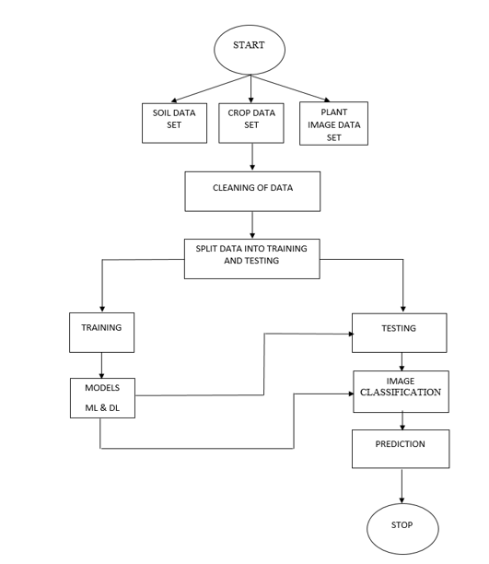
Architecture

Slide 10
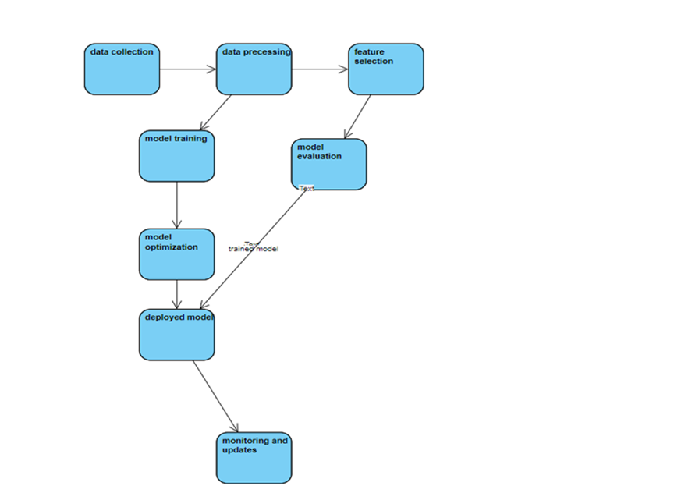
Architecture

Slide 11
Software Components
➢ User Interface
➢ Integration
➢ Crop Data Management
➢ Data Protection and Accuracy
➢ API Gateway

Slide 12
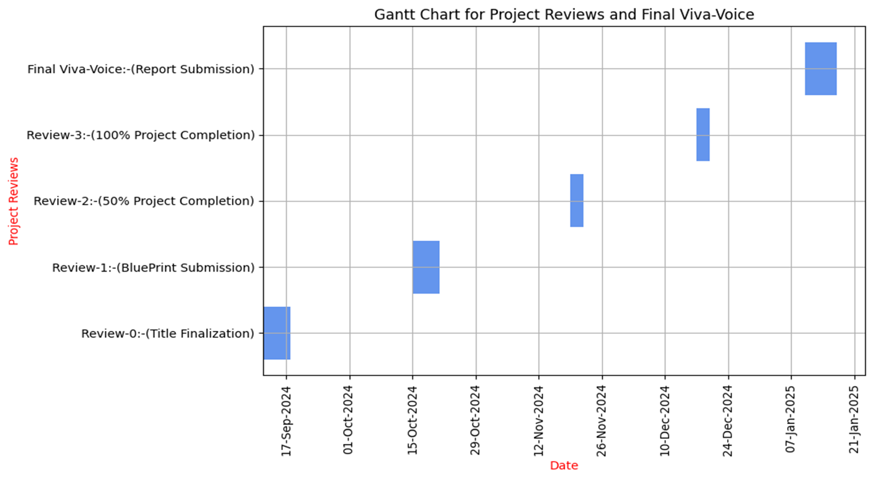
Timeline of Project

Slide 13
Expected Outcomes
Accuracy Crop Prediction
Decision-Making for Farmers
Increased Crop Yield and Profitability
Detect Disease from plants

Slide 14
Conclusion
After reviewing various research and technologies, it is clear that machine learning is an important toolfor predicting crop yields and helping make decisions such as crop selection . In this project we have used different models like Data Collection and preprocessing data, future selection, Model training and Validation, Model Evaluation and Interpolation, Deployment and Monitoring it is important to consider,variablesfor crop forecasting, and machine learning algorithms can help farmers decide which crops to plant, ultimately increasing yields.Machine learning techniques can improve agricultural yield prediction and decision making. By accurately predicting crop yields, farmers can reduce crop losses, get the best price for their crops, and ultimately improve their livelihoods.

Slide 15
Github Link
https://github.com/padigapatisudharshan2713/Ai-Solutions-for-Farmers

Slide 16
References
https://www.sciencedirect.com/science/article/pii/S2214317323000458
https://acsess.onlinelibrary.wiley.com/doi/full/10.1002/agj2.21353
https://pdfs.semanticscholar.org/3314/15efe806be5cbb4e4cf7a1c4c6d29a17dab9.pdf
https://philpapers.org/rec/ALTAII
https://www.e3sconferences.org/articles/e3sconf/abs/2024/07/e3sconf_star2024_00057/e3sconf_star2024_00057
https://acsess.onlinelibrary.wiley.com/doi/full/10.1002/agj2.21353
https://www.sciencedirect.com/science/article/abs/pii/S0952197623000830
https://www.sciencedirect.com/science/article/pii/S0261219423003447

Slide 17
Project work mapping with SDG
Our Project aligns with several key SDG’s are:
AI-driven solutions optimize crop yields, reduce losses, and improve food availability. By helping farmers produce more efficiently, these tools contribute to food security and the fight against hunger.(SDG 2: Zero Hunger).
Machine learning-based irrigation systems ensure efficient water usage, reducing water wastage in agriculture. This supports sustainable water management and helps conserve water resources.(SDG 6: Clean Water and Sanitation).
AI technologies increase farm productivity and profitability, creating economic growth opportunities for farmers. By automating routine tasks, they also allow farmers to focus on high-value activities.(SDG 8: Decent Work and Economic Growth).
AI-driven supply chain transparency improves traceability and reduces wastage in the agricultural supply chain. This promotes responsible production practices and ensures better quality control.(SDG 12: Responsible Consumption and Production).
AI models that predict climate-related threats, like droughts or pest outbreaks, help farmers adapt to climate change. By promoting efficient resource use, they also reduce the environmental impact of farming.(SDG 13: Climate Action).

Slide 18
Thank You

